Slide 1
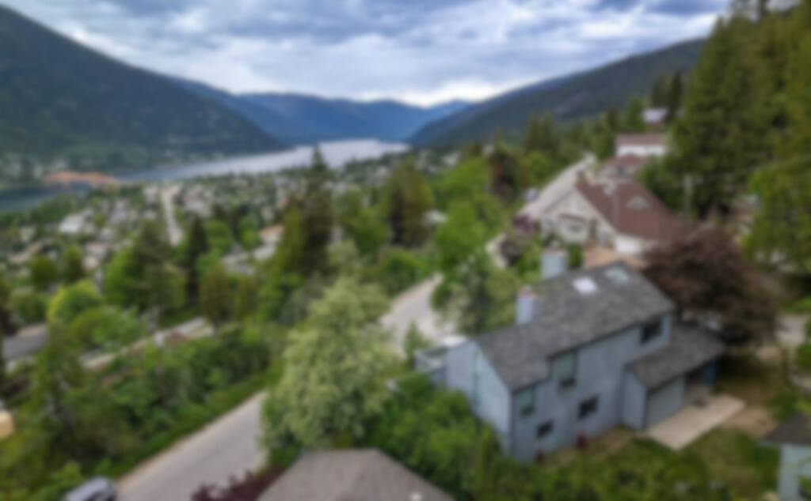
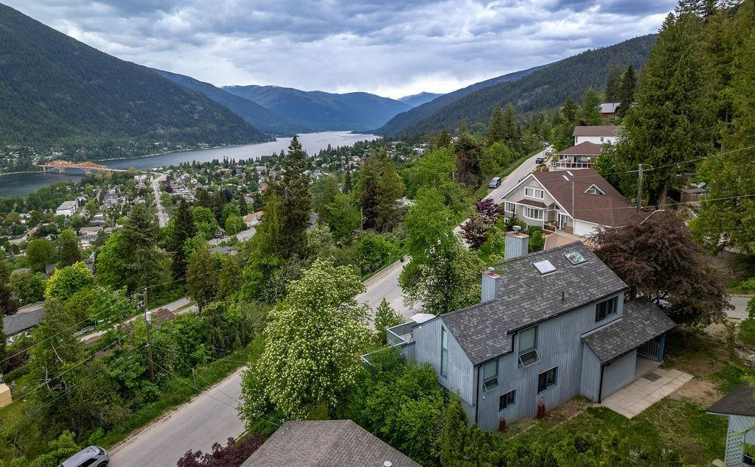
Report to Council
TREVOR
STREET
ACCESS & EGRESS
Aug 20, 2024

Slide 2
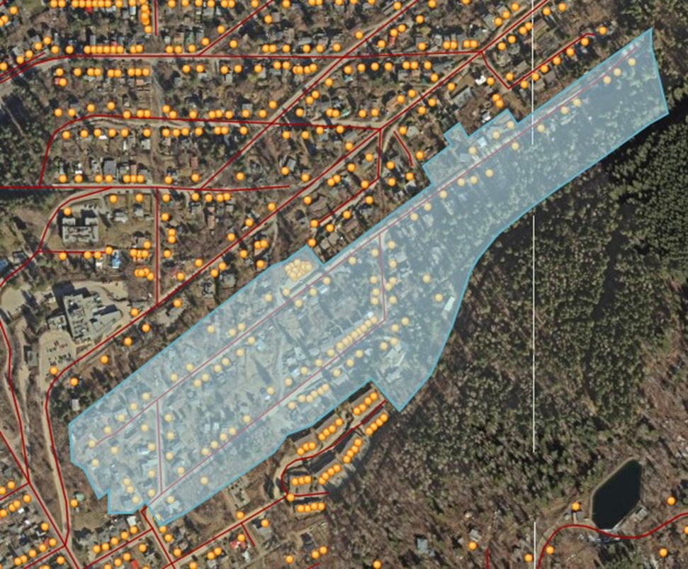
AREA OF CONCERN
114 Homes
Trevor, Regent and Selby Streets
ONE WAY IN & ONE WAY OUT

Slide 3
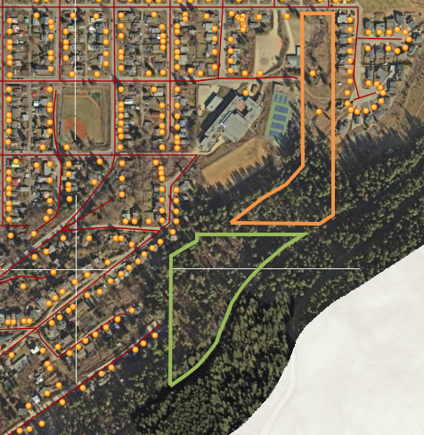
LANDS
OF
INTEREST
CITY OWNED PROPERTY
PRIVATE LANDS IN QUESTION

Slide 4
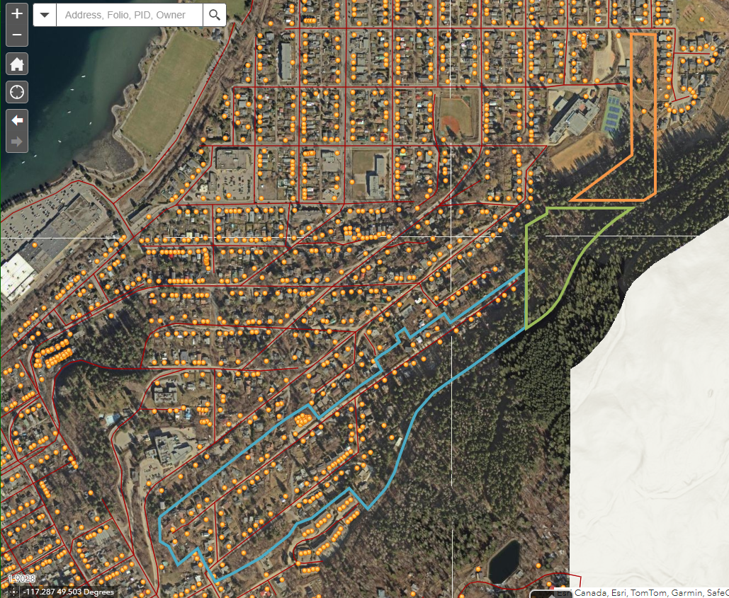
CITY OWNED PROPERTY
PRIVATE LANDS IN QUESTION
AREA OF CONCERN &
LANDS OF INTEREST
AREA OF CONCERN

Slide 5
WHY IS THIS AN AREA OF CONCERN?

Slide 6
Trevor St area residents are at an increased risk of aggressive wildfire behaviour due to slope, fuel type, and exposure to embers.

Slide 7

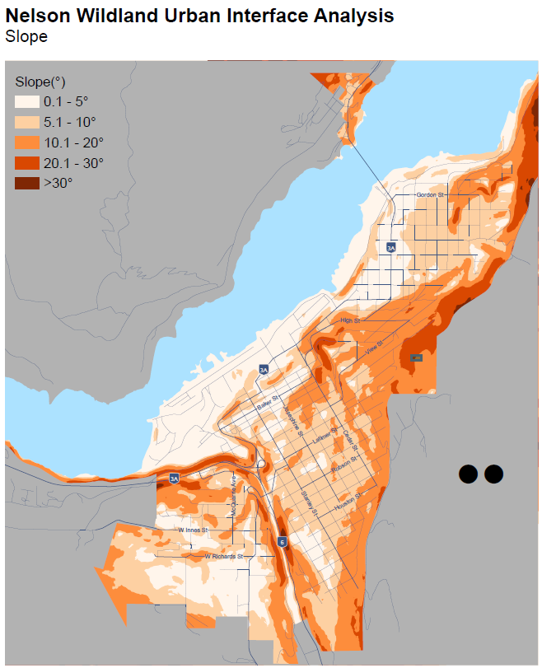
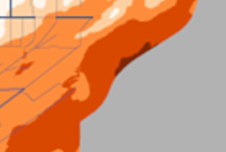
SLOPE:
how it affects fire behaviour
Slope:
20.1->30 degrees
above
Trevor Street

Slide 8
Fire moves faster uphill. In fact, for every 10-degree increase in slope, a fire will double in speed. This is because the slope provides a similar effect to the wind, effectively laying the flames down into the slope and pre-heating the vegetation, allowing it to ignite more rapidly.

Slide 9
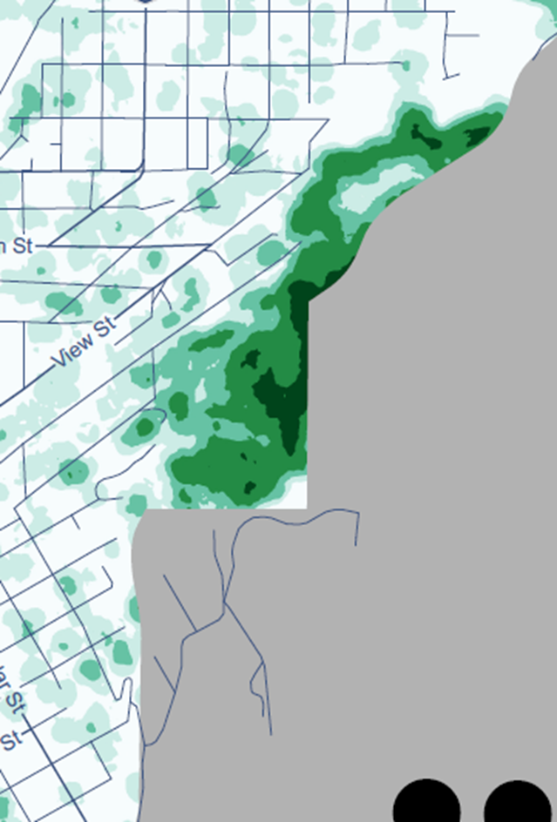
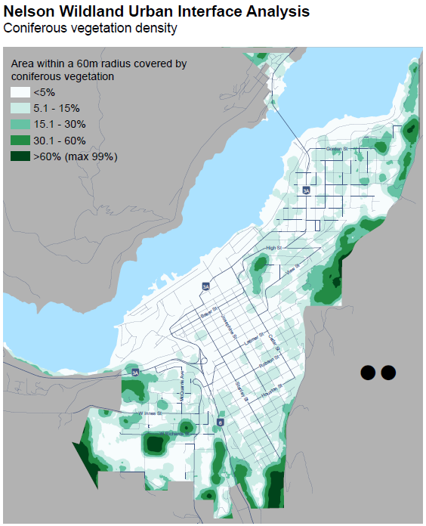
NELSON WILDLAND URBAN INTERFACE ANALYSIS
CONIFER VEGETATION DENSITY

Slide 10
More than 90% of homes damaged or destroyed by wildfires are ignited by EMBERS
Source: FireSmart BC

Slide 11
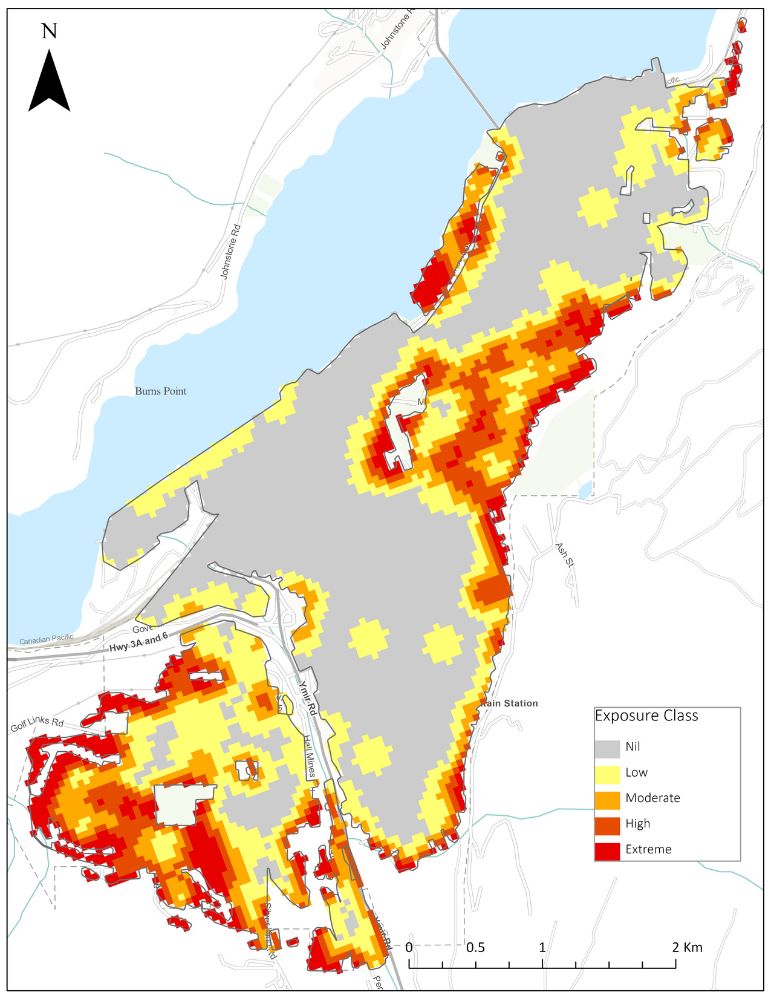
SHORT RANGE
EMBER SPOTTING
FOR NELSON
Dr. Jen Beverly, Associate Professor with the University of Alberta. 25 years experience studying wildfire.
Trevor Street community is at risk of short range ember spotting. This map shows that risk from moderate to extreme

Slide 12
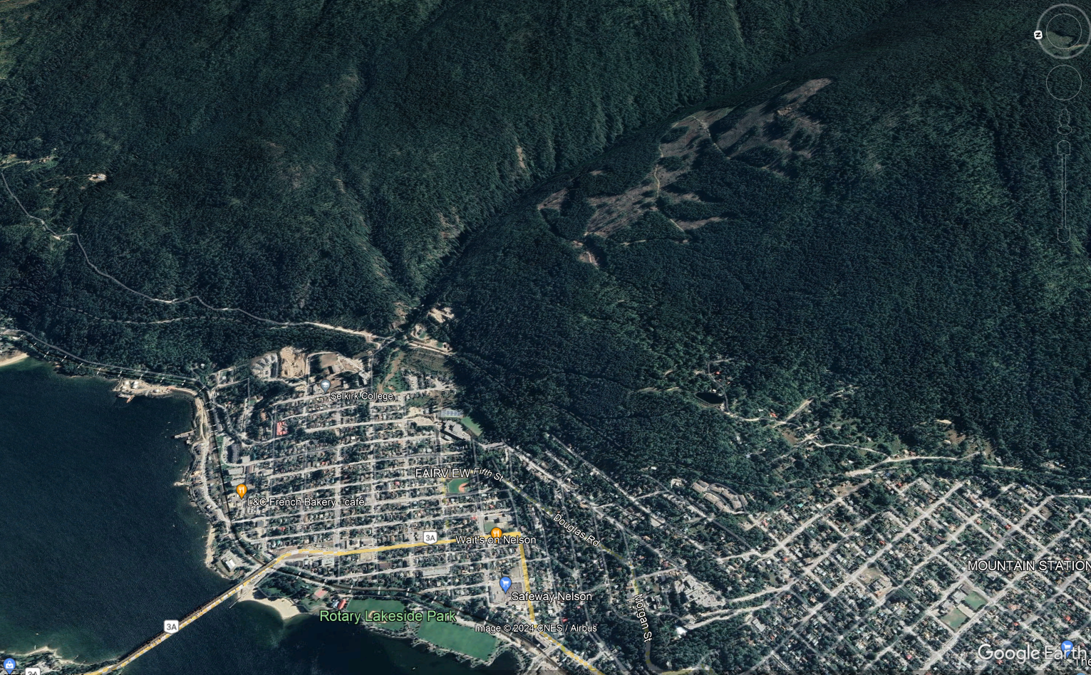
APPROACH PATHWAYS

Slide 13
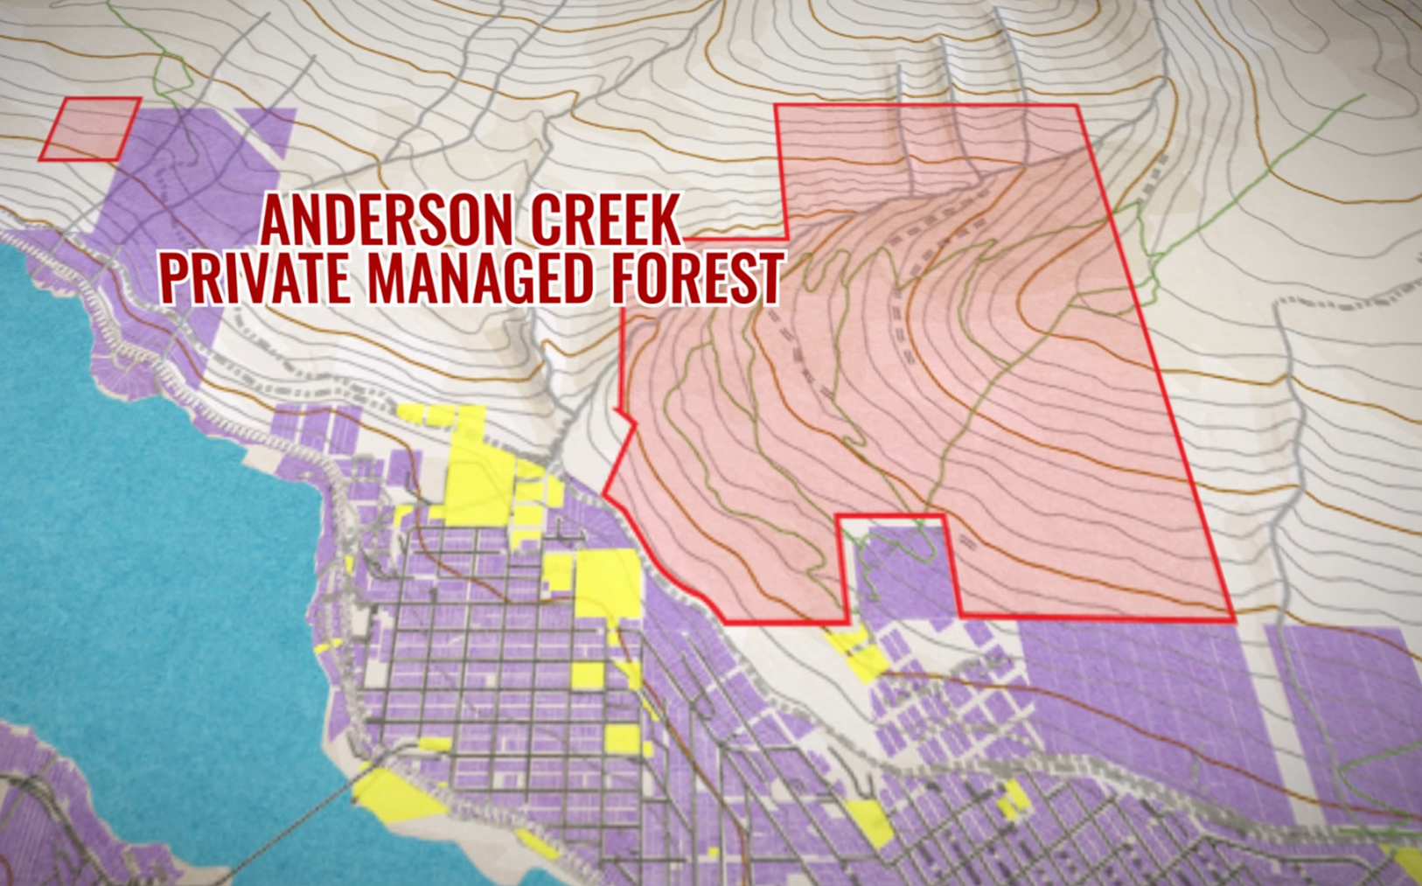
ADJACENT PRIVATELY MANAGED FOREST
Private Managed Forest

Slide 14
Anderson Creek Timber presents a large fuel load adjacent to the community, the City needs to capitalize on any opportunity to enhance fuel mitigation within its boundaries to try and offset this risk until additional solutions can be developed on a larger scale.

Slide 15
We are unable to apply for grant funding on privately owned lands. A land swap would provide us the opportunity to fuel mitigate a buffer between the community and the Interface

Slide 16
During a wildfire, areas with inadequate access/egress routes will be triaged, severely limiting response tactics.

Slide 17
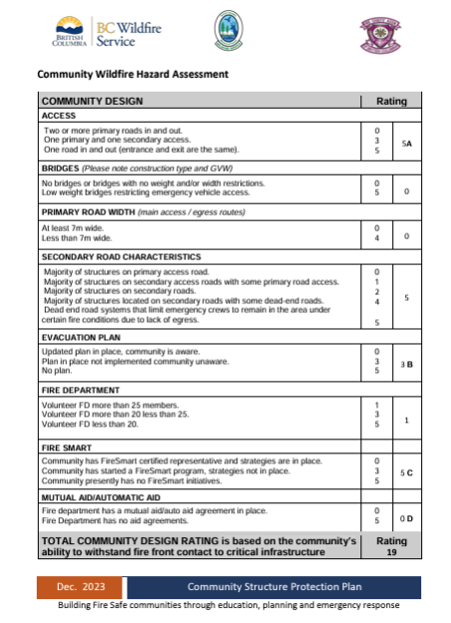
BCWS Considerations on Structure Protection:
The BCWS emphasizes that during wildfire incidents, the safety of first responders is paramount. Structures that are difficult to access due to single-road entry points or limited turnaround space pose increased risks to fire crews. As a result, these structures may not receive protection if the situation does not allow for safe operations.

Slide 18
Trevor Street single access route is over 1000 meters long, where as the City’s bylaw states the maximum length of dead-end development is no longer than 250m. This single-access route also goes against National best practices.

Slide 19
NFPA 1141:
Standard for Fire Protection Infrastructure for Land Development in Wildland, Rural, and Suburban Areas
11.1.4 Number of Means of Access
A land development shall have one or more means of access in accordance with the below table:
NUMBER OF HOUSEHOLDS | NUMBER OF ACCESS ROUTES
0-100 | 1
101-600 | 2
>600 | 3
NUMBER OF PARKING SPACES | NUMBER OF ACCESS ROUTES
0-1250 | 1
1251-3000 | 2
>3000 | 3
Required Number of Access Routes for Residential Areas
Trevor, Regent and Selby Streets have 114 households and only 1 Access Route
Required Number of Access Routes for Nonresidential Areas

Slide 20
Inadequate access and egress routes have been responsible for hundreds of fatalities over recent years.

Slide 21
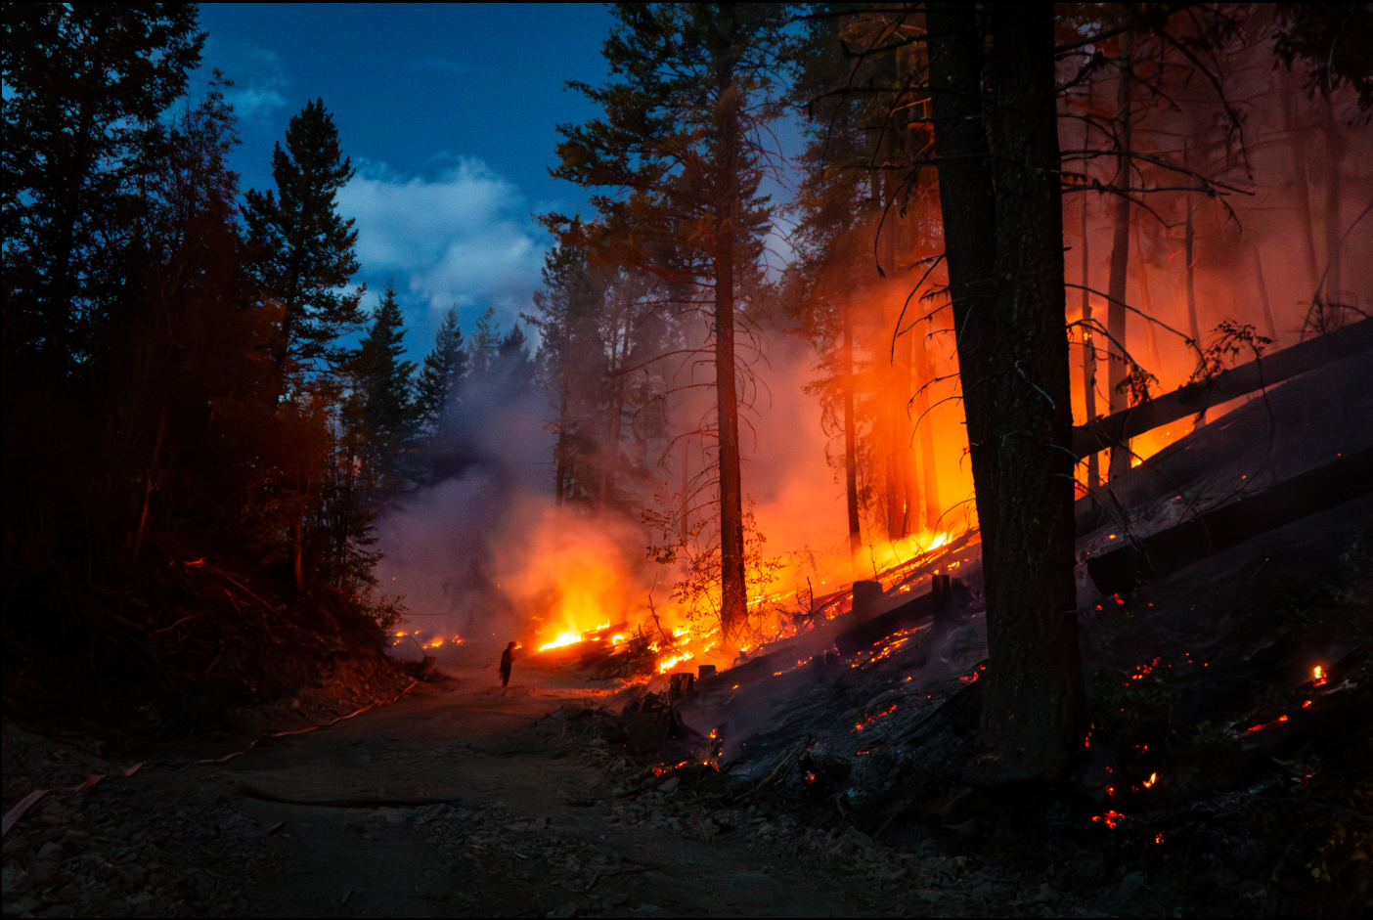
LIMITED EGRESS
leading to negative outcomes
during wildfire evacuations
New South Wales Bushfires (2019-2020)
Black Summer Bushfires Report:
"The fires resulted in 26 fatalities, with significant impact attributed to the limited evacuation routes and the rapid spread of fires in areas with only one point of ingress and egress“
(Black Summer Bushfires Report, p. 65)​ (Australian Disaster Resilience Hub)​ (NSW Environment and Heritage)
Lahaina Fire
Lahaina Fire Comprehensive Timeline Report:
"Approximately 20% of Hawaiʻi's developed communities have only one point of ingress and egress. The limited evacuation routes during the Lahaina fire on August 8, 2023, led to severe traffic congestion and delays, significantly impacting the ability of residents to evacuate quickly, contributing to the tragic outcomes - 102 fatalities;"​ (FSRI)​ (U.S. Fire Administration).
Camp Fire
NIST Technical Note 2252: A Case Study of the Camp Fire - Notification, Evacuation, Traffic, and Temporary Refuge Areas (NETTRA): 86 fatalities
"Evacuation was constrained by burnovers that closed the main egress artery... The presence of only one egress route in some areas severely limited the ability to evacuate safely and quickly"
(NIST Technical Note 2252, p. 65). NIST Technical Note 2252: A Case Study of the Camp Fire - Notification, Evacuation, Traffic, and Temporary Refuge Areas (NETTRA)

Slide 22
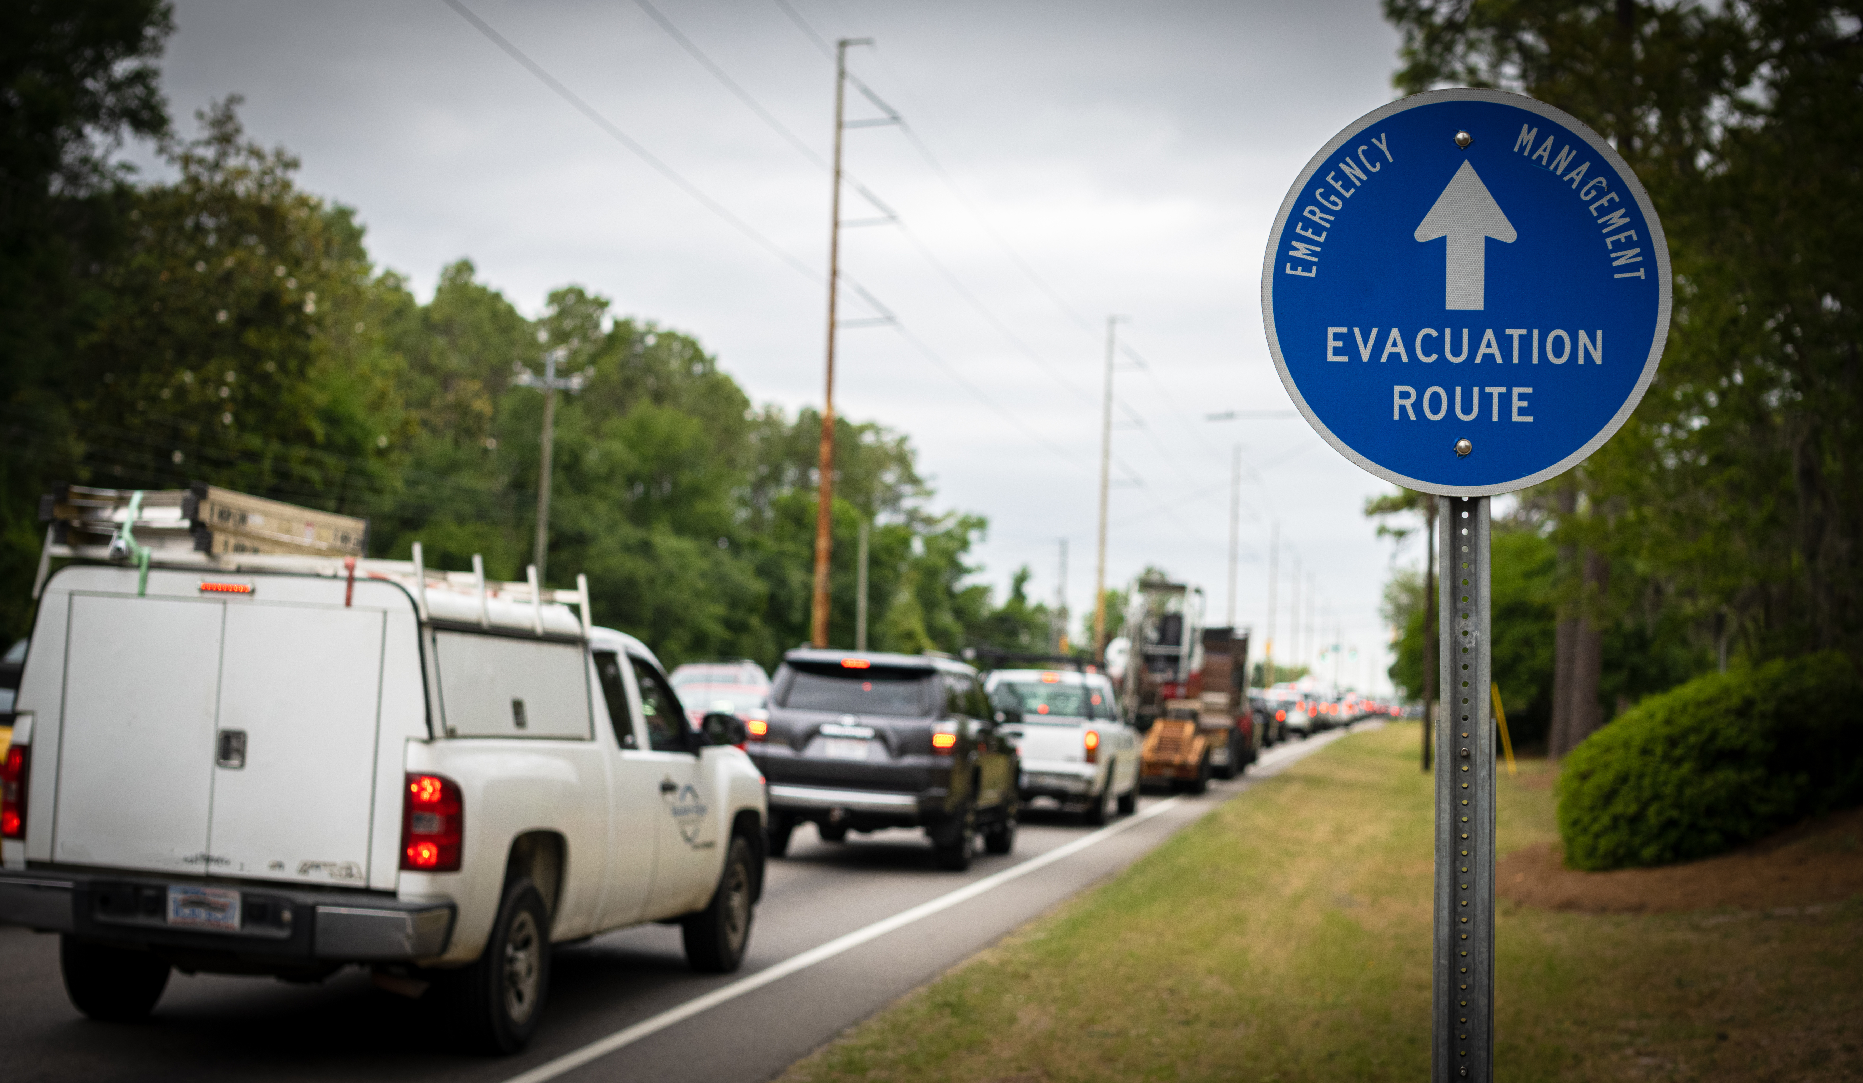
Example of:
REACTIVE Secondary Access Routes

Slide 23
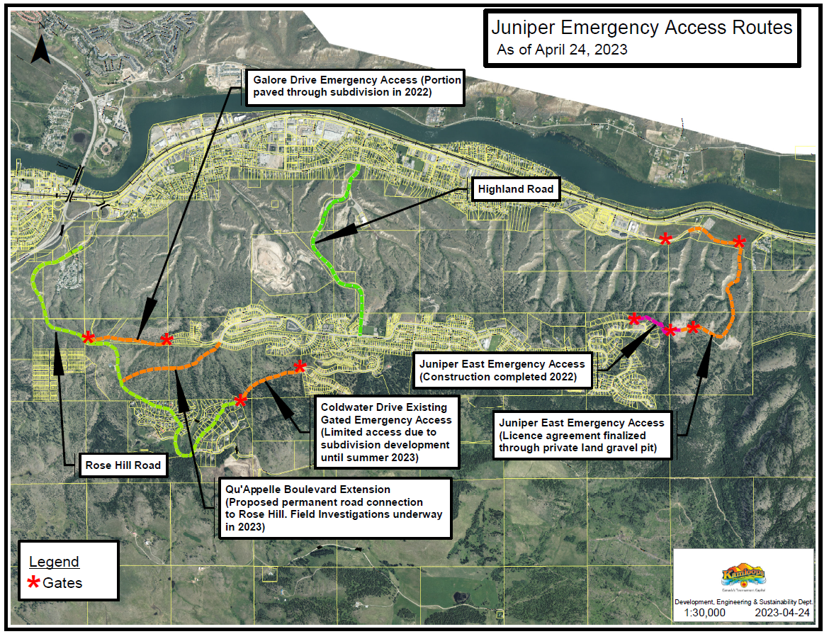
Kamloops BC response to recent wildfires.
Development of additional emergency access routes.

Slide 24
Nelson now has the opportunity to begin developing proactive secondary access/egress routes

Slide 25

THANK YOU
Aug 20, 2024

